Slide 1




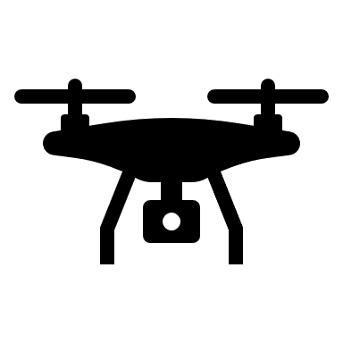
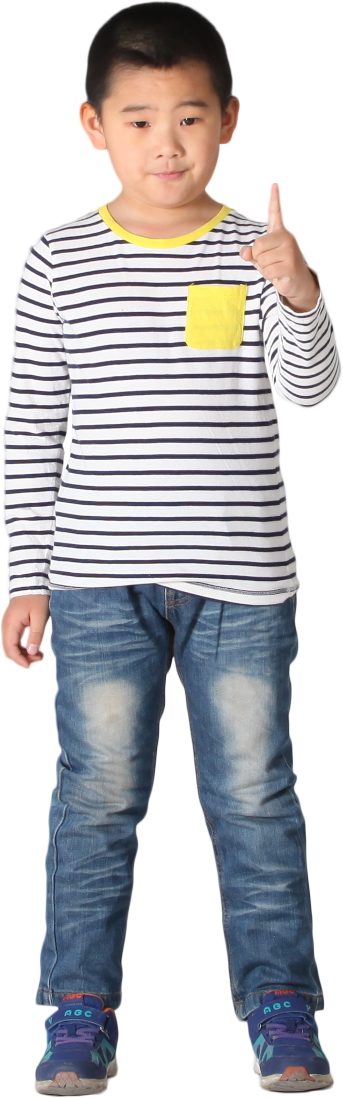
UAV controlled by hand signs
Give instruction with hand signs
Capture images
Detect hand
Receive instruction from computer
Subscribe to MQTT server
Recognize hand sign
Publish instruction
Receive instruction
Send instruction to MQTT server
Execute instruction

